Slide 1
Databases 2
Denis McCarthy
demccarthy@ait.ie
RoomU302

Slide 2
SQL Assessment
Sample Questions and Solutions

Slide 3
What’s in the assessment?
Based on the “World” database
18 questions
10 easy
5 medium
3 hard
Union
Intersect
Except

Slide 4
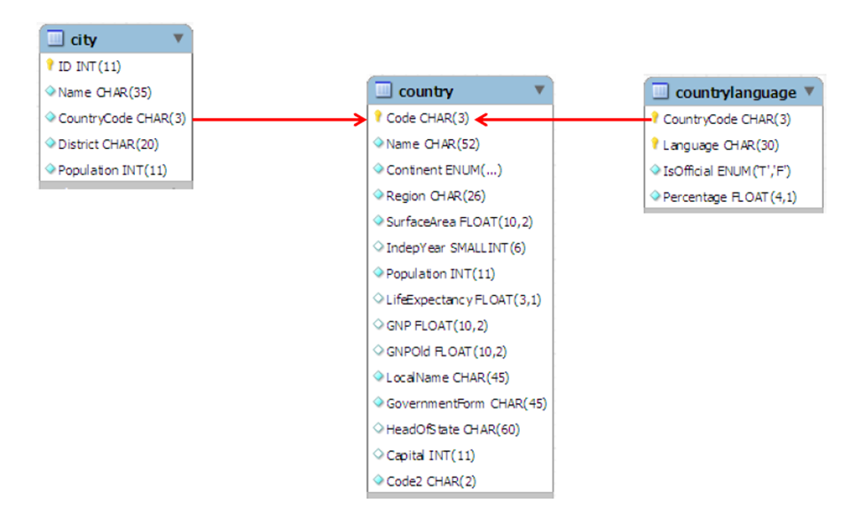
The World Database

Slide 5
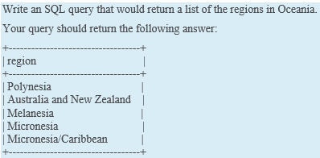
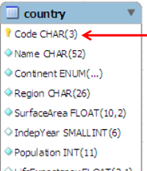
Easy questions (1 table only)
SELECT DISTINCT region FROM country WHERE continent = ‘oceania’;

Slide 6
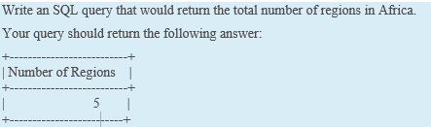
Easy questions (1 table only)
SELECT COUNT(DISTINCT region) AS 'Number of Regions' FROM country WHERE continent = 'africa';

Slide 7
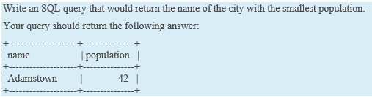
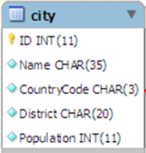
Easy questions (1 table only)
SELECT name, population FROM city WHERE population = (SELECT MIN(population) FROM city);

Slide 8
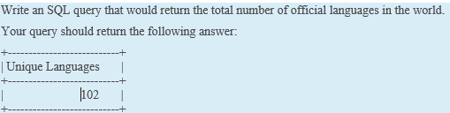
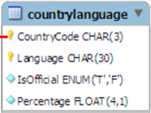
Easy questions (1 table only)
SELECT COUNT(DISTINCT language) AS 'Unique Languages' FROM countrylanguage WHERE isofficial = 't';

Slide 9
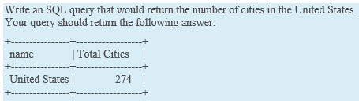
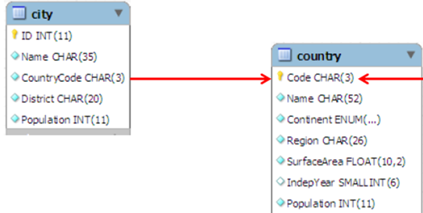
Medium questions (2 tables)
SELECT country.name, count(city.name) FROM country, city
where code = countrycode
and country.name = 'United states';

Slide 10
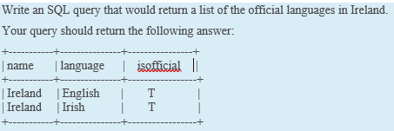
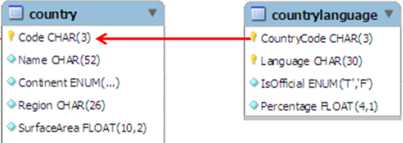
Medium questions (2 tables)
select name, language, isofficial FROM country, countrylanguage
where code = countrycode
AND isofficial = 'T' AND name = 'ireland';

Slide 11
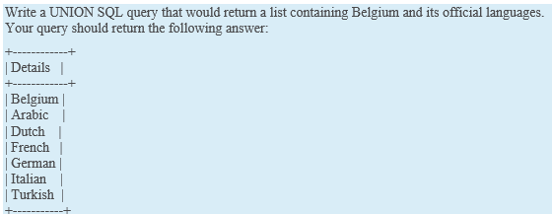
Hard questions (UNION)
(SELECT name AS 'Details' FROM country WHERE name = 'Belgium')
UNION
(select language from countrylanguage, country
where code = countrycode
and name = 'Belgium');

Slide 12
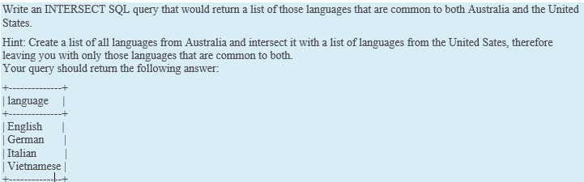
Hard questions (INTERSECT)
select language from countrylanguage inner join country on code = countrycode
where name = 'Australia'
intersect
select language from countrylanguage inner join country on code = countrycode
where name = 'United States';

Slide 13
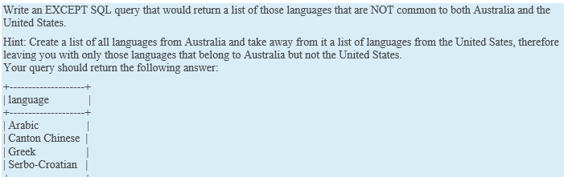
Hard questions (EXCEPT)
select language from countrylanguage inner join country on code = countrycode
where name = 'Australia’
except
select language from countrylanguage inner join country on code = countrycode
where name = 'United States';

Slide 14
Any Questions?

